Slide 1
Bayesian Optimization with Known Optimum Demo： Benchmark Functions & Tuning XGBoost Hyperparameters
Ref.：Knowing The What But Not The Where in Bayesian Optimization
Digital Twin｜DRC｜07/20/2022
彭家祐 (Jack) Intern

Slide 2


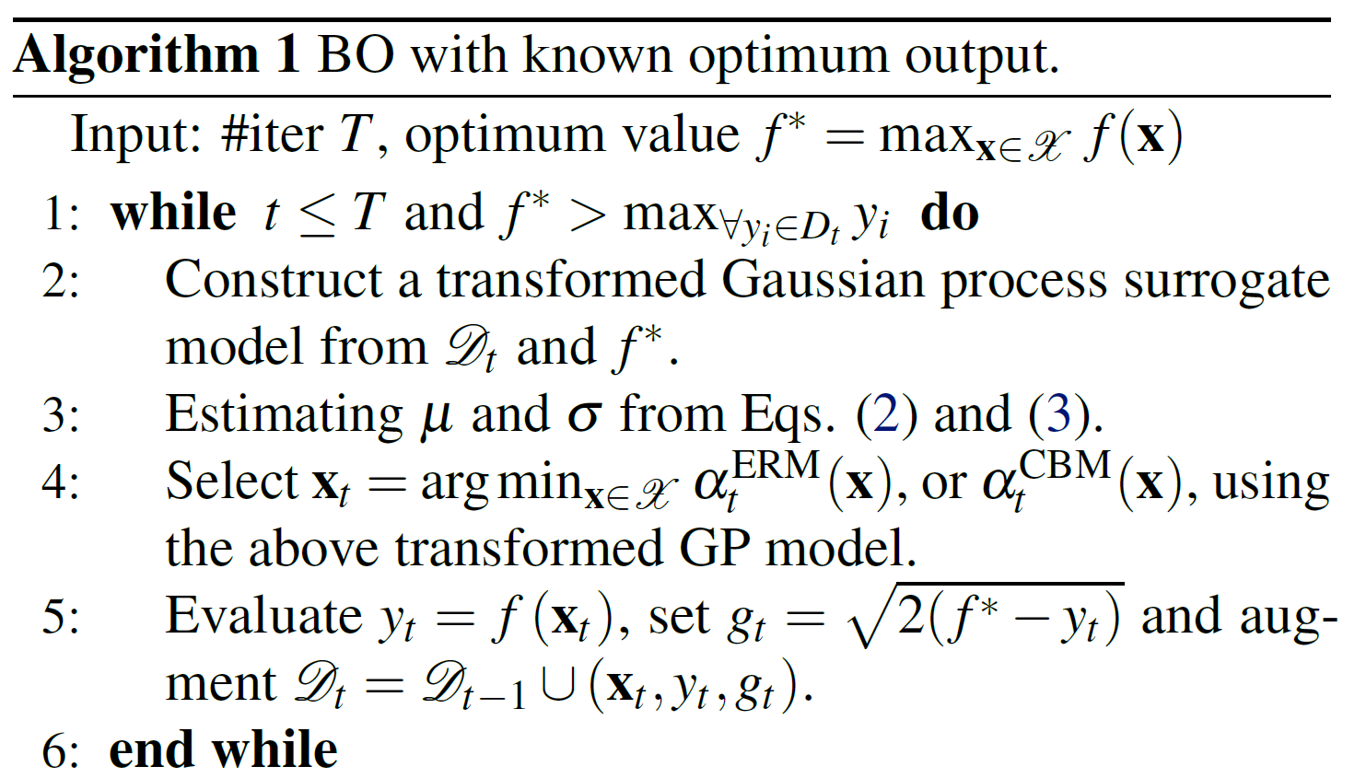
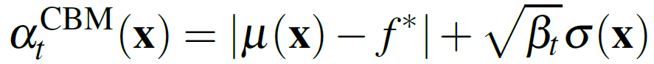
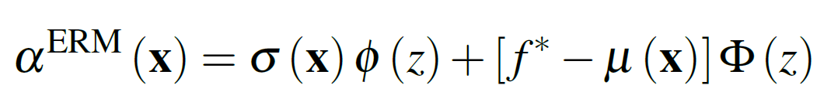


Algorithm – BO with known optimum output
Given original observation and f*, compute to build a transformed GP
Using transformed GP, predict the mean and variance at any location x
compute the CBM and ERM acquisition functions to select next point
Proposed Acquisition Functions：
Confidence Bound Minimization
Expected Regret Minimization
Take the minimum value
at ideal location where ,

Slide 3
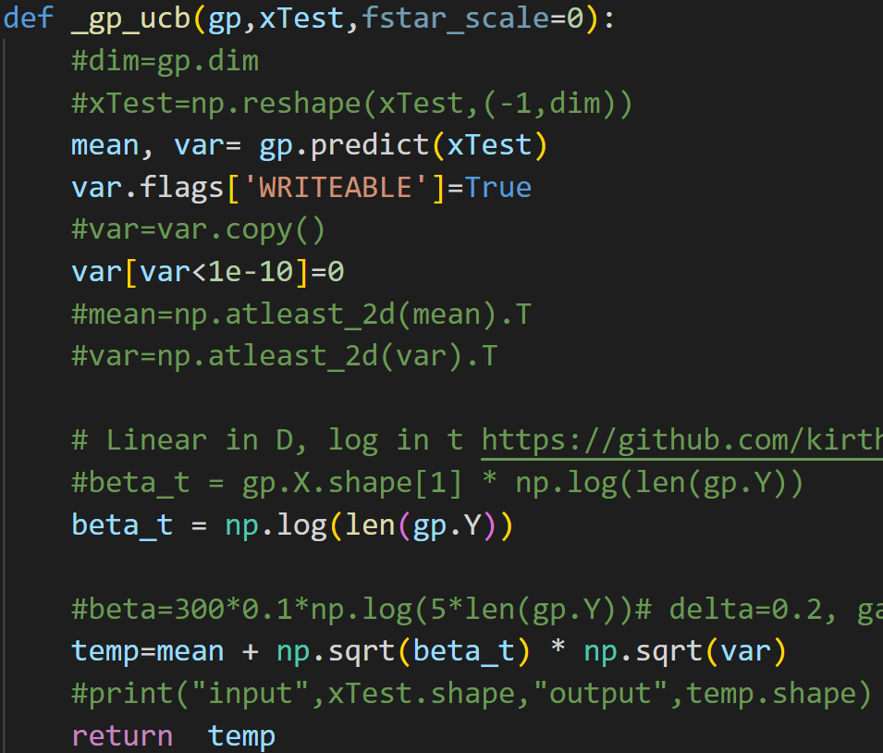
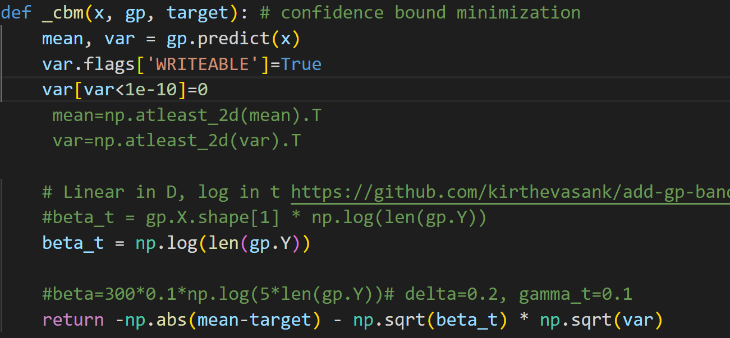

The setting of Beta for UCB & CBM
$β=\log{ ( \# of GP fitting points)}$
more iteration → more data → 𝛽 be larger

Slide 4
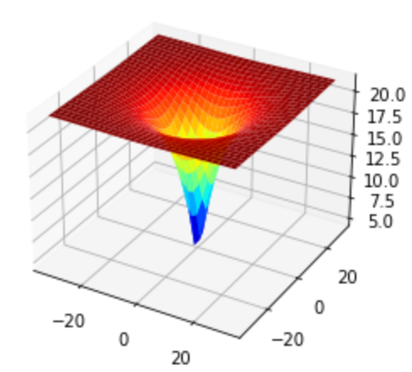
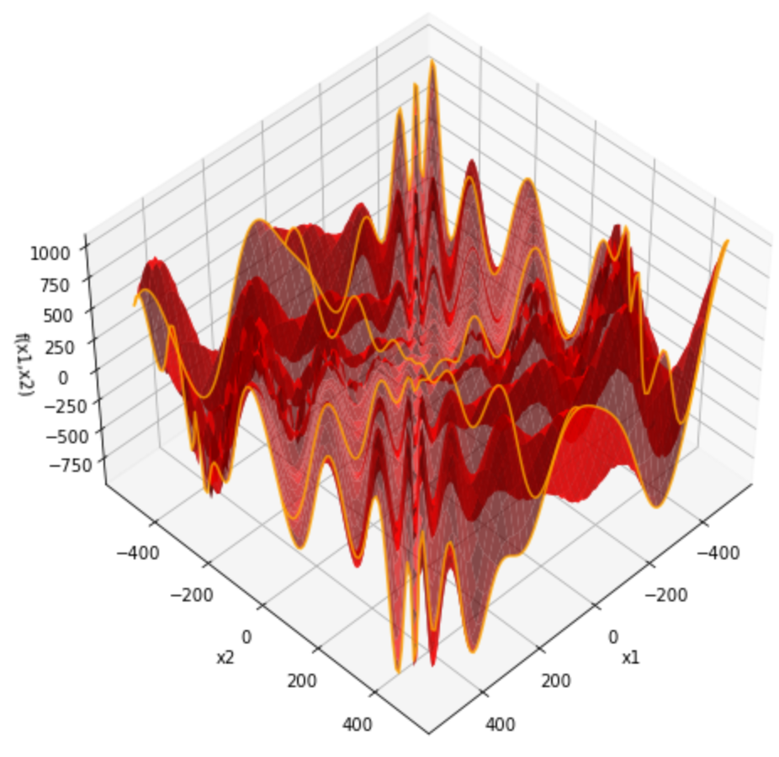
Demo - 2D - Other Benchmark Functions
Ackley (minimization)
f* = 0
x* = (0,0)
較平滑、椎狀
Eggholder (minimization)
f* = -959.6407
x* = (512, 404.2319)
上下起伏、震盪
Methods
Random
GP-UCB
GP-EI
TGP-UCB
TGP-EI
TGP-CBM
TGP-ERM
times -1 → maximization

Slide 5
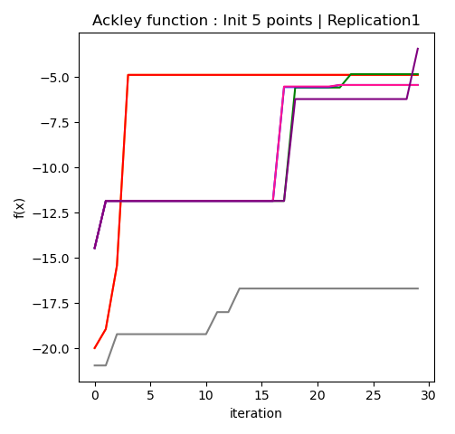
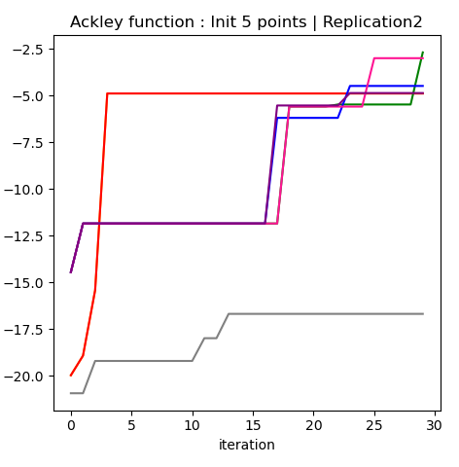
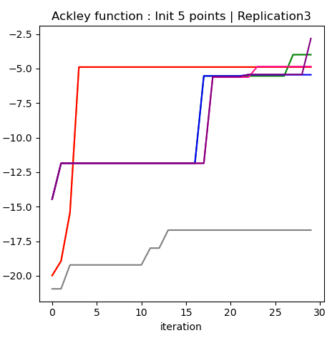
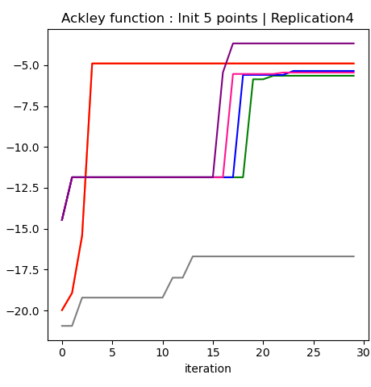
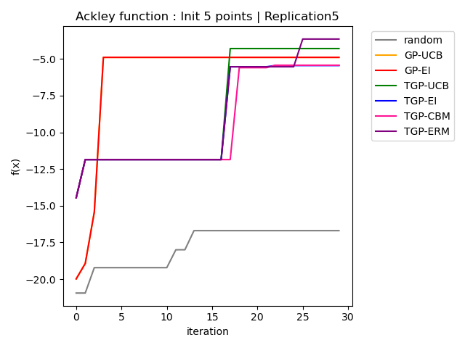
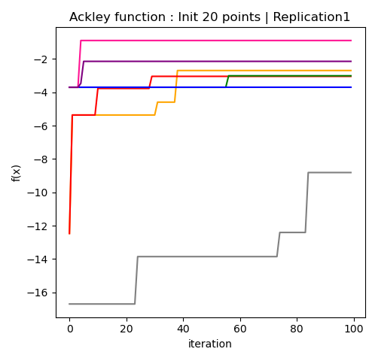
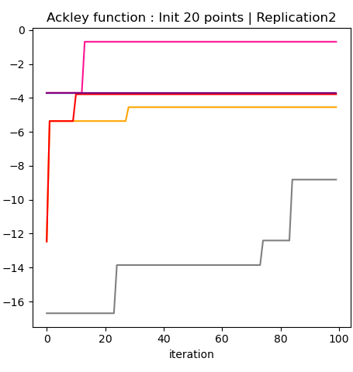
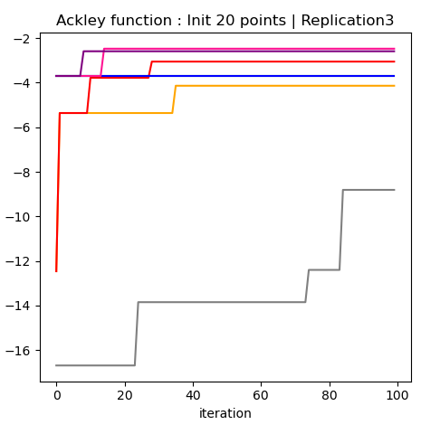
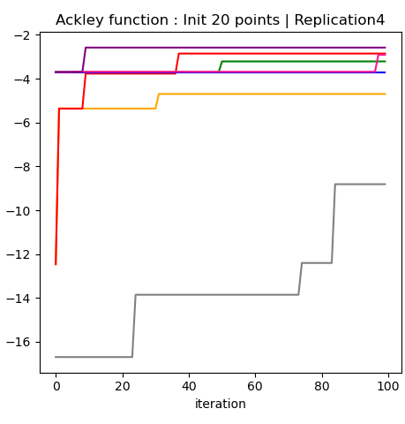
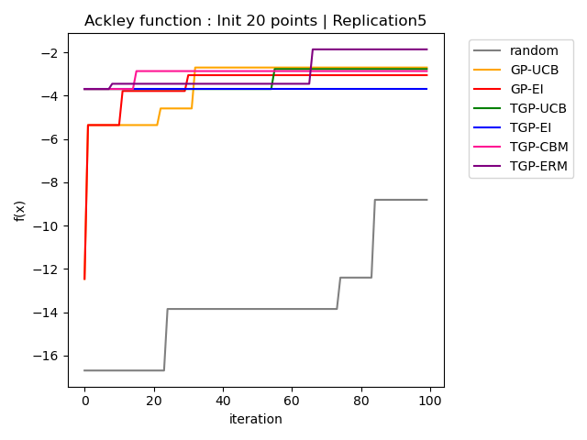
Demo - 2D - Ackley Function | f* = 0
Init 5 points | 30 iterations
TGP - ERM 有四次最佳
Init 20 points | 100 iterations
TGP - ERM 有兩次最佳
TGP - CBM 有三次最佳

Slide 6
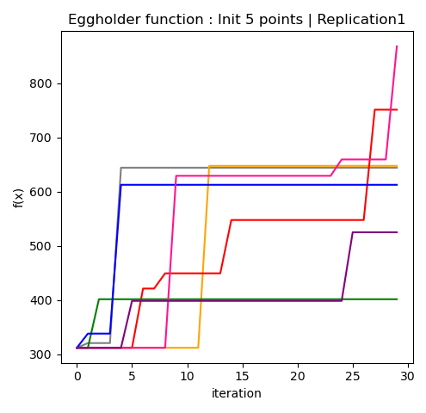
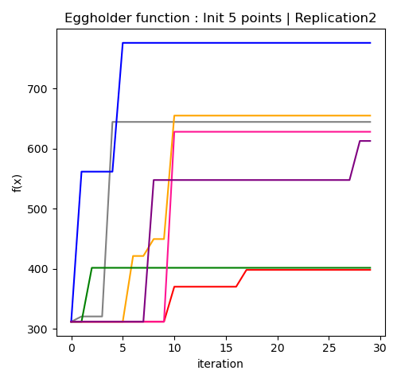
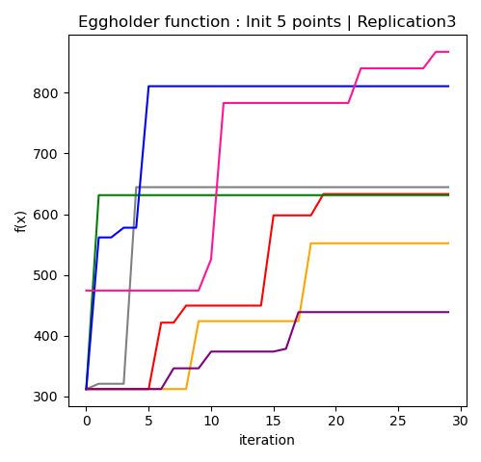
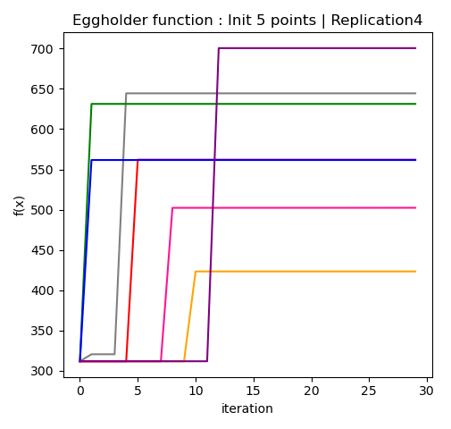
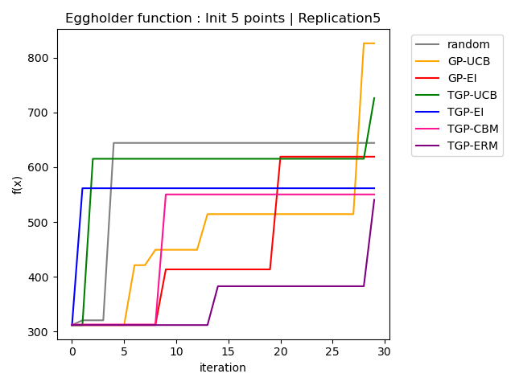
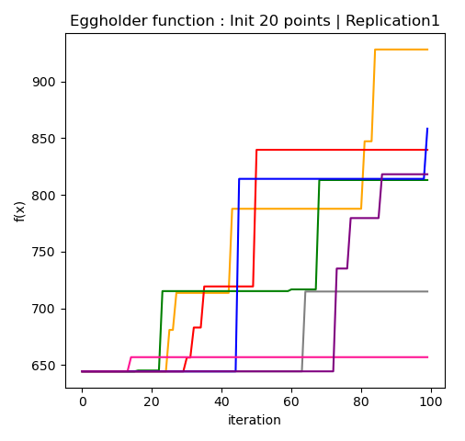
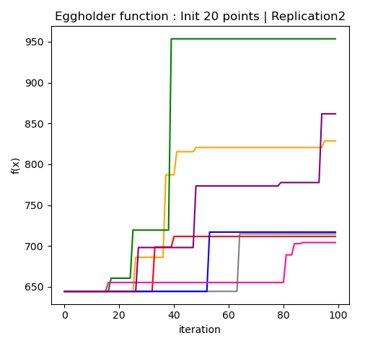
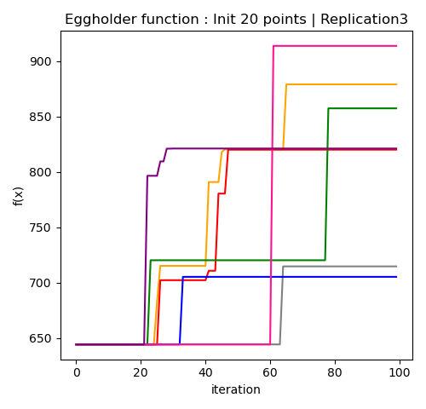
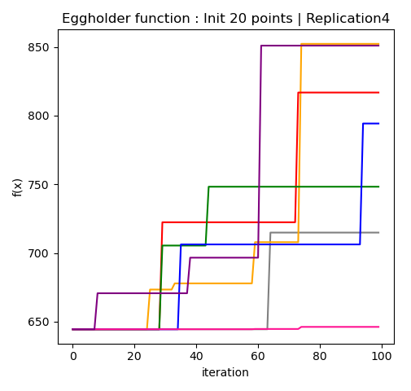
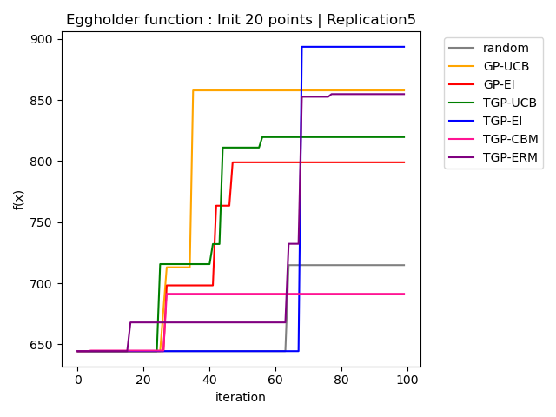
Demo - 2D - Eggholder Function | f* = -959.6407 * -1
Init 5 points | 30 iterations
Init 20 points | 100 iterations
相較於Ackley Function的實驗，proposed acquisition function表現無較好
black box function很震盪→ UCB、EI偏好high variance，找到最佳組合的機率會較高?
(但現實面無法得知Black Box Function 長得如何)

Slide 7
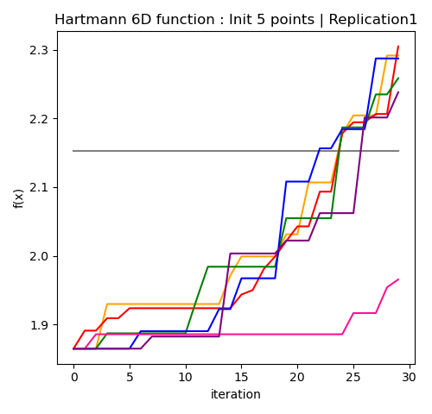
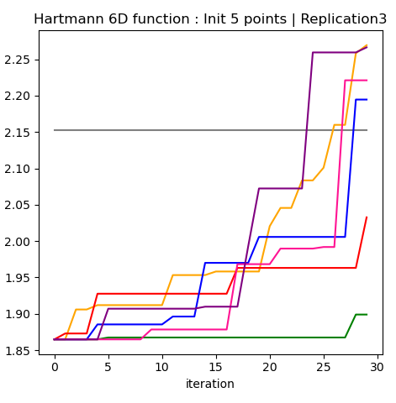
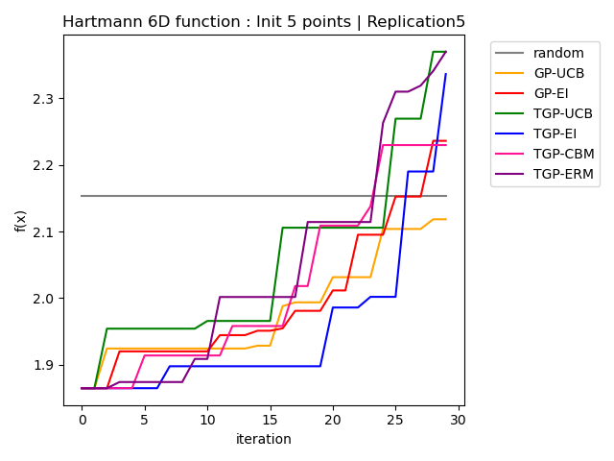
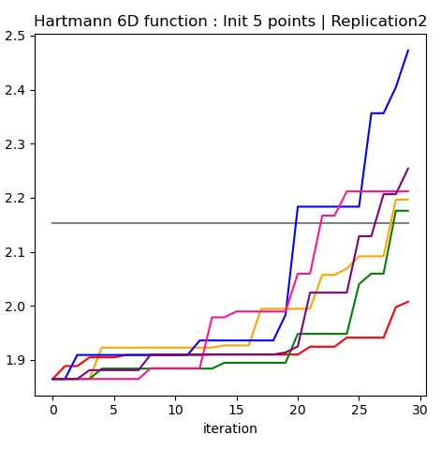
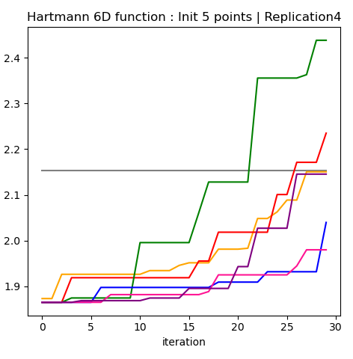
Demo - 6D – Hartmann Function | f* = -3.32237* -1
Init 5 points | 30 iterations
TGP - ERM 有兩次最佳

Slide 8
Demo – Tuning Hyperparameters of XGBoost
Tuning 4 hyperparameters of XGBoost
Data：iris dataset
Metric：Accuracy → Maximization
Goal：raise Accuracy
Black Box Function
x
y
Setosa
Virginica
Versicolor
Versicolor
Setosa
…
…
hyperparameter | boundary
Max_depth | (3, 9)
eta | (0.1, 0.5)
min_child_weight | (1, 20)
colsample_bytree | (0.1, 1)
XGBoost
predict
Accuracy
Training：10%
Testing：90%
Iris data

Slide 9
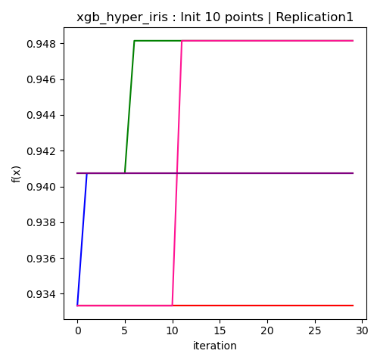
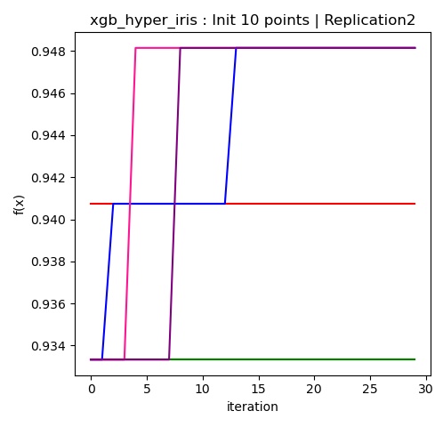
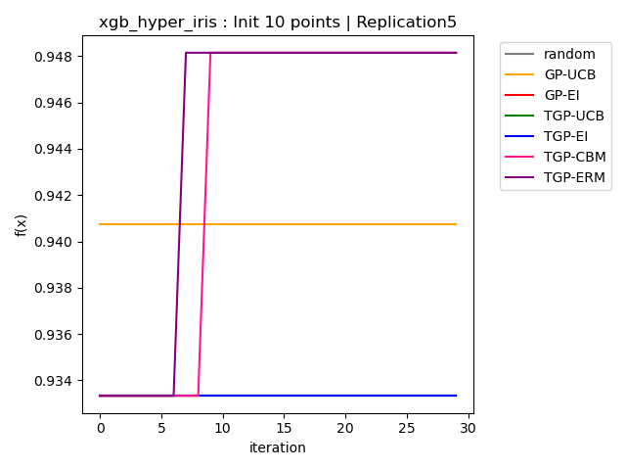
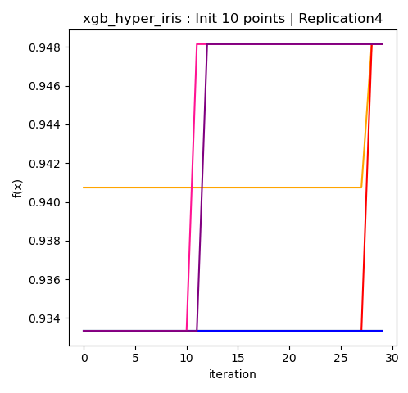
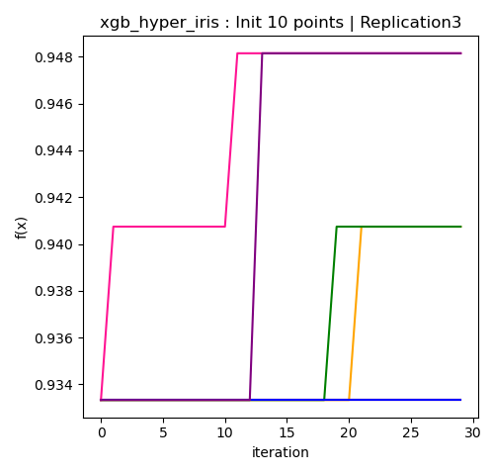
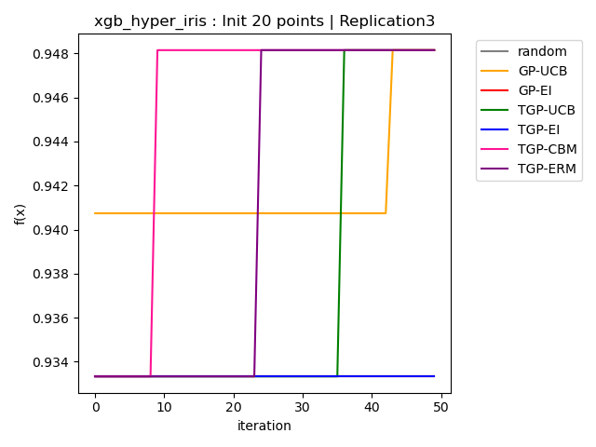
Demo – Tuning Hyperparameters of XGBoost
Init 10 points | 30 iterations
TGP – CBM每次皆最優，且四次為最快收斂
TGP – ERM幾乎每次皆收斂，且收斂快速
Init 20 points | 50 iterations

Slide 10
小結
實驗方式
上述實驗皆以設立特定迭代次數
與目標值差值的停止迭代機制之驗證(不同方法收斂所需的迭代次數)方式難以進行、耗時
Experiments of benchmark functions
平滑的black box function：acquisition function使用ERM或CBM的表現較佳
震盪的black box function：使用EI、UCB較佳
Tuning 4 hyperparameters of XGBoost with Iris Dataset
acquisition function使用CBM的表現最佳，ERM也表現不錯
Transformed GP 若搭配EI、UCB，實驗無明顯效果

